Slide 1
Lecture 31-33
Transactions

Slide 2
Serializable
View Serializable: A Schedule is called view serializable if it is view equal to a serial schedule. A conflict schedule is a view serializable but if the serializability contains blind writes, then the view serializable does not conflict serializable.

Slide 3
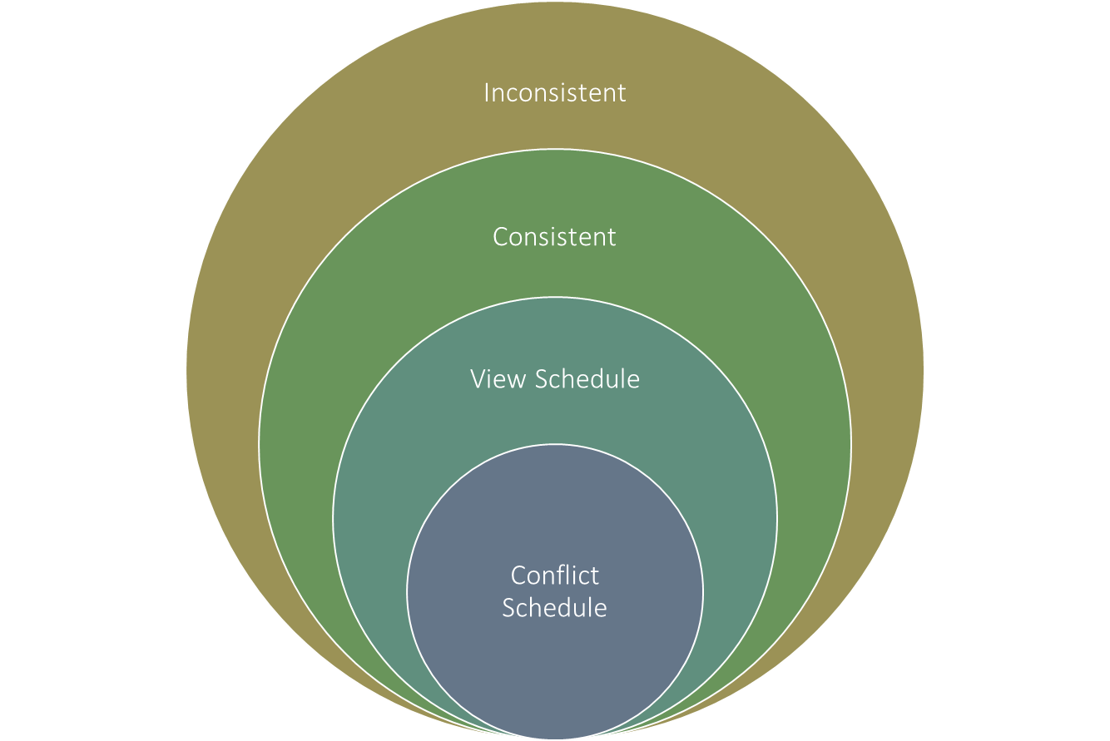

Slide 4
View Equivalent Schedule
Consider two schedules S1 and S2 each consisting of two transactions T1 and T2.
Schedules S1 and S2 are called view equivalent if the following three conditions hold true for them

Slide 5
Condition#1
For each data item X, if transaction Ti reads X from the database initially in schedule S1, then in schedule S2 also, Ti must perform the initial read of X from the database.
“Initial readers must be same for all the data items”.

Slide 6
Condition#2
If transaction Tj reads a data item that has been updated by the transaction Ti in schedule S1, then in schedule S2 also, transaction Tj must read the same data item that has been updated by the transaction Ti.
“Write-read sequence must be same.”.

Slide 7
Condition#3
For each data item X, if X has been updated at last by transaction Ti in schedule S1, then in schedule S2 also, X must be updated at last by transaction Ti.
“Final writers must be same for all the data items”.

Slide 8
Checking Whether a schedule is serializable or not?
Method 1: Check whether the given schedule is conflict serializable or not.
Method 2: Check if there exists any blind write operation.
Method 3: Try to find a view equivalent serial schedule.

Slide 9
Method#1
Check whether the given schedule is conflict serializable or not.
If the given schedule is conflict serializable, then it is surely view serializable. Stop and report your answer.
If the given schedule is not conflict serializable, then it may or may not be view serializable. Go and check using other methods.
All conflict serializable schedules are view serializable.
All view serializable schedules may or may not be conflict serializable.

Slide 10
Method#2
Check if there exists any blind write operation.
(Writing without reading is called as a blind write).
If there does not exist any blind write, then the schedule is surely not view serializable. Stop and report your answer.
If there exists any blind write, then the schedule may or may not be view serializable. Go and check using other methods.
No blind write means not a view serializable schedule.

Slide 11
Method#3
In this method, try finding a view equivalent serial schedule.
By using the three conditions, write all the dependencies.
Then, draw a graph using those dependencies.
If there exists no cycle in the graph, then the schedule is view serializable otherwise not.

Slide 12
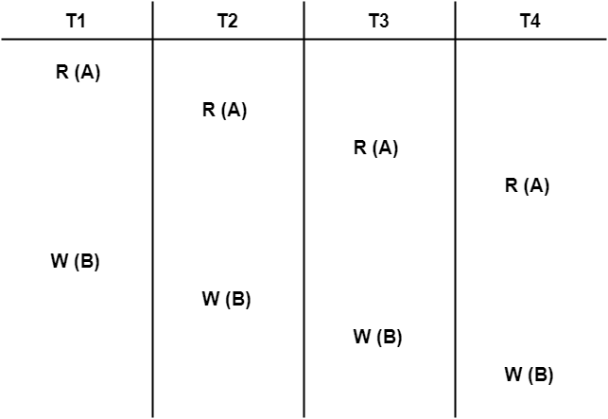
Problem#1

Slide 13
Solution
We know, if a schedule is conflict serializable, then it is surely view serializable.
So, let us check whether the given schedule is conflict serializable or not.

Slide 14
Step#1
List all the conflicting operations and determine the dependency between the transactions-
W1(B) , W2(B) (T1 → T2)
W1(B) , W3(B) (T1 → T3)
W1(B) , W4(B) (T1 → T4)
W2(B) , W3(B) (T2 → T3)
W2(B) , W4(B) (T2 → T4)
W3(B) , W4(B) (T3 → T4)

Slide 15
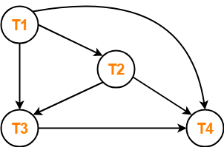
Step#2
Draw a graph
Clearly, there exists no cycle in the precedence graph.
Therefore, the given schedule S is conflict serializable.
Thus, we conclude that the given schedule is also view serializable.

Slide 16
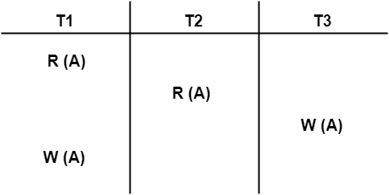
Problem#2

Slide 17
Solution
We know, if a schedule is conflict serializable, then it is surely view serializable.
So, let us check whether the given schedule is conflict serializable or not.

Slide 18
Step#1
List all the conflicting operations and determine the dependency between the transactions-
R1(A) , W3(A) (T1 → T3)
R2(A) , W3(A) (T2 → T3)
R2(A) , W1(A) (T2 → T1)
W3(A) , W1(A) (T3 → T1)

Slide 19
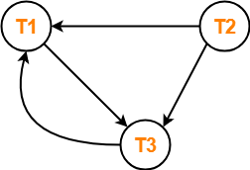
Step#2
Draw a graph

Slide 20
Clearly, there exists a cycle in the precedence graph.
Therefore, the given schedule S is not conflict serializable.
Now,
Since, the given schedule S is not conflict serializable, so, it may or may not be view serializable.
To check whether S is view serializable or not, let us use another method.
Let us check for blind writes.

Slide 21
Checking for Blind Writes
There exists a blind write in T3 W(A) in the given schedule S.
Therefore, the given schedule S may or may not be view serializable.
Now,
To check whether S is view serializable or not, let us use another method.

Slide 22
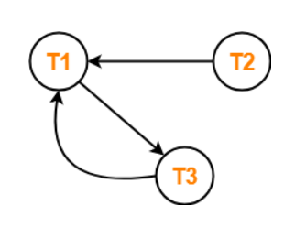
Drawing a Dependency Graph
T1 firstly reads A and T3 firstly updates A.
So, T1 must execute before T3.
Thus, we get the dependency T1 → T3.
Final updation on A is made by the transaction T1.
So, T1 must execute after all other transactions.
Thus, we get the dependency (T2, T3) → T1.
There exists no write-read sequence.
Now, let us draw a dependency graph using these dependencies-
Clearly, there exists a cycle in the dependency graph.
Thus, we conclude that the given schedule S is not view serializable.

Slide 23
Non-serializable
A non-serial schedule which is not serializable is called as a non-serializable schedule.
A non-serializable schedule is not guaranteed to produce the same effect as produced by some serial schedule on any consistent database.
Non-serializable schedules-
may or may not be consistent
may or may not be recoverable

Slide 24
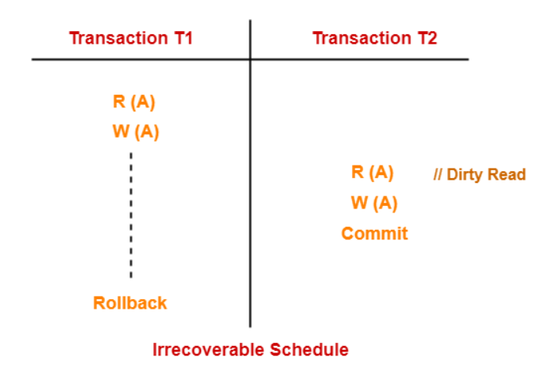
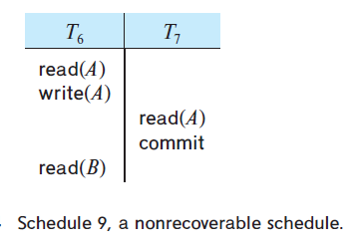
Non-Recoverable Schedule:
If in a schedule, a transaction performs a dirty read operation from an uncommitted transaction and commits before the transaction from which it has read the value then such a schedule is known as an Irrecoverable Schedule.

Slide 25
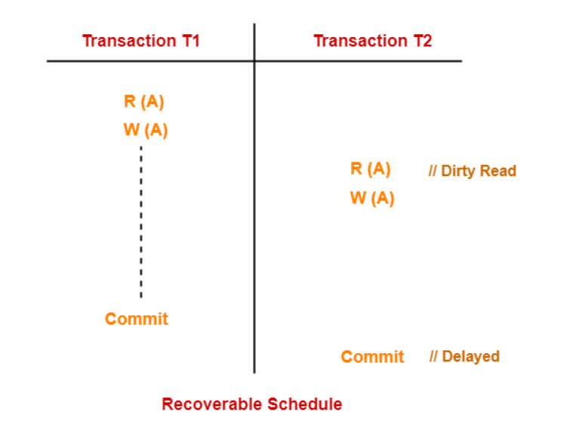
Recoverable Schedule
Schedules in which transactions commit only after all transactions whose changes they read commit are called recoverable schedules.
Cascading Schedule
Cascade less Schedule
Strict Schedule

Slide 26
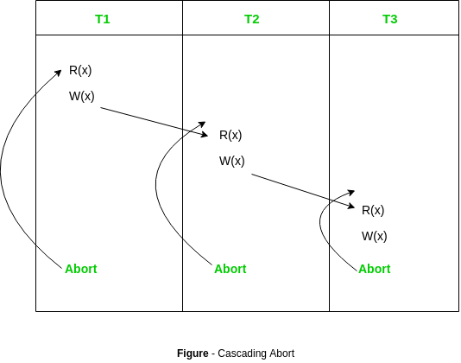
Cascading Schedule
If in a schedule, failure of one transaction causes several other dependent transactions to rollback or abort, then such a schedule is called as a Cascading Schedule or Cascading Rollback or Cascading Abort.
It simply leads to the wastage of CPU time.

Slide 27
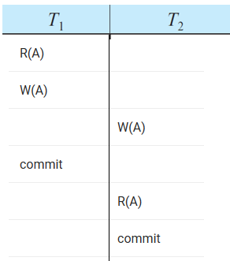
Cascadeless Schedule:
If in a schedule, a transaction is not allowed to read a data item until the last transaction that has written it is committed or aborted, then such a schedule is called as a Cascadeless Schedule.
Cascadeless schedule allows only committed read operations.
However, it allows uncommitted write operations.

Slide 28
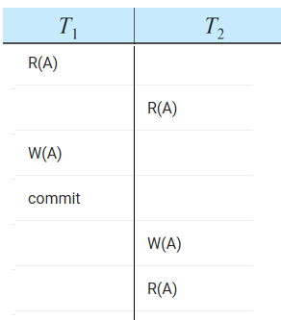
Strict schedule
If in a schedule, a transaction is neither allowed to read nor write a data item until the last transaction that has written it is committed or aborted, then such a schedule is called as a Strict Schedule.

Slide 29
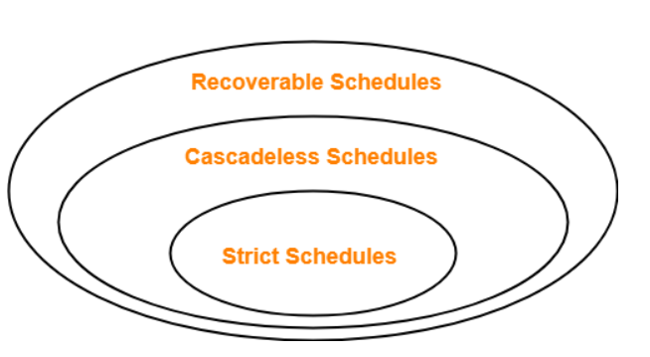
Strict schedules are more strict than cascadeless schedules.
All strict schedules are cascadeless schedules.
All cascadeless schedules are not strict schedules.

Slide 30
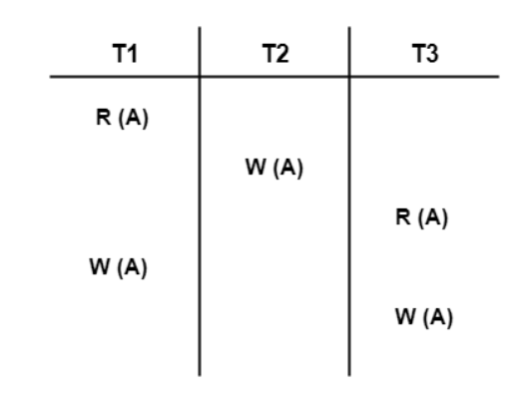
Check whether the given schedule S is view serializable or not. If yes, then give the serial schedule.

Slide 31
Checking Whether S is Conflict Serializable Or Not-
List all the conflicting operations and determine the dependency between the transactions-
R₁(A) , W₂(A) (T₁ → T₂)
R₁(A) , W₃(A) (T₁ → T₃)
W₂(A) , R₃(A) (T₂ → T₃)
W₂(A) , W₁(A) (T₂ → T₁)
W₂(A) , W₃(A) (T₂ → T₃)
R₃(A) , W₁(A) (T₃ → T₁)
W₁(A) , W₃(A) (T₁ → T₃)

Slide 32
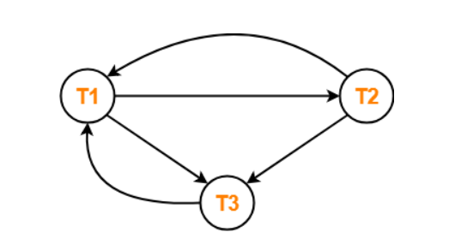
Draw the precedence graph-
Clearly, there exists a cycle in the precedence graph.
Therefore, the given schedule S is not conflict serializable.

Slide 33
Checking for blind wirtes
There exists a blind write W₂ (A) in the given schedule S.
Therefore, the given schedule S may or may not be view serializable.

Slide 34
Drawing a Dependency Graph-
T1 firstly reads A and T2 firstly updates A.
So, T1 must execute before T2.
Thus, we get the dependency T1 → T2.
Final updation on A is made by the transaction T3.
So, T3 must execute after all other transactions.
Thus, we get the dependency (T1, T2) → T3.
From write-read sequence, we get the dependency T2 → T3

Slide 35
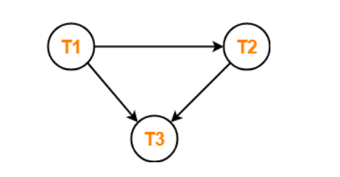
Clearly, there exists no cycle in the dependency graph.
Therefore, the given schedule S is view serializable.
The serialization order T1 → T2 → T3.

Slide 36
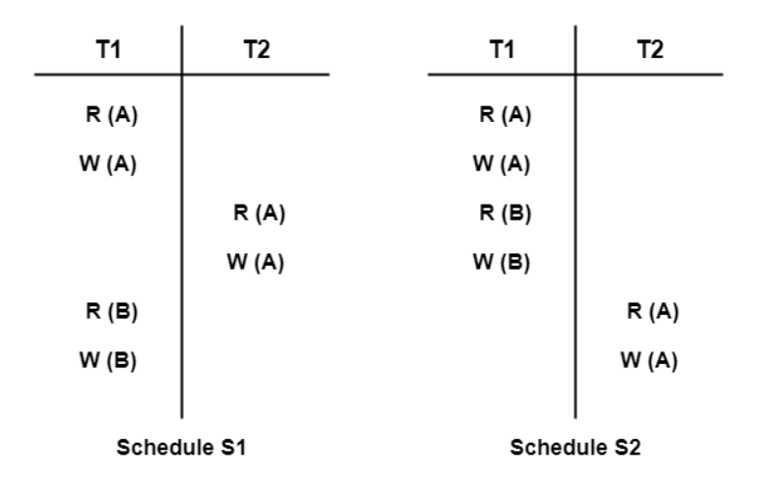
Are the following two schedules conflict equivalent?

Slide 37
Yes both are equivalent
For schedule S1-
The required order is-
R₁(A) , W₂(A)
W₁(A) , R₂(A)
W₁(A) , W₂(A)
For schedule S2-
The required order is-
R₁(A) , W₂(A)
W₁(A) , R₂(A)
W₁(A) , W₂(A

Slide 38
Suggested Reading
Chapter 22 of Database Systems: A Practical Approach to Design, Implementation, and Management by Thomas Conolly 6th Edition
Chapter 14, 15 of Database System Concepts by Abraham Silberschatz

Slide 39
References
https://www.db-book.com/db6/slide-dir/index.html
https://www.pearson.com/us/higher-education/product/Connolly-Powerpoint-Slides-for-Database-Systems
https://www.gatevidyalay.com/equivalence-of-schedules-equivalent-schedules-in-dbms/

